Slide 1
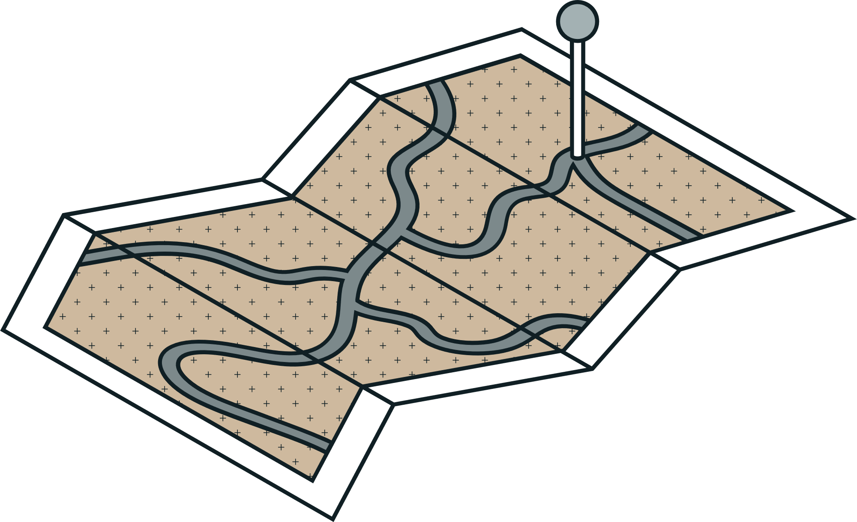





ALINGAS • ARADO • AYOP • BAHIAN • BALCITA • GARRIDOS
THESISHIVE:
DMS MINI THESIS
LIBRARY
Software Engineering

Slide 2
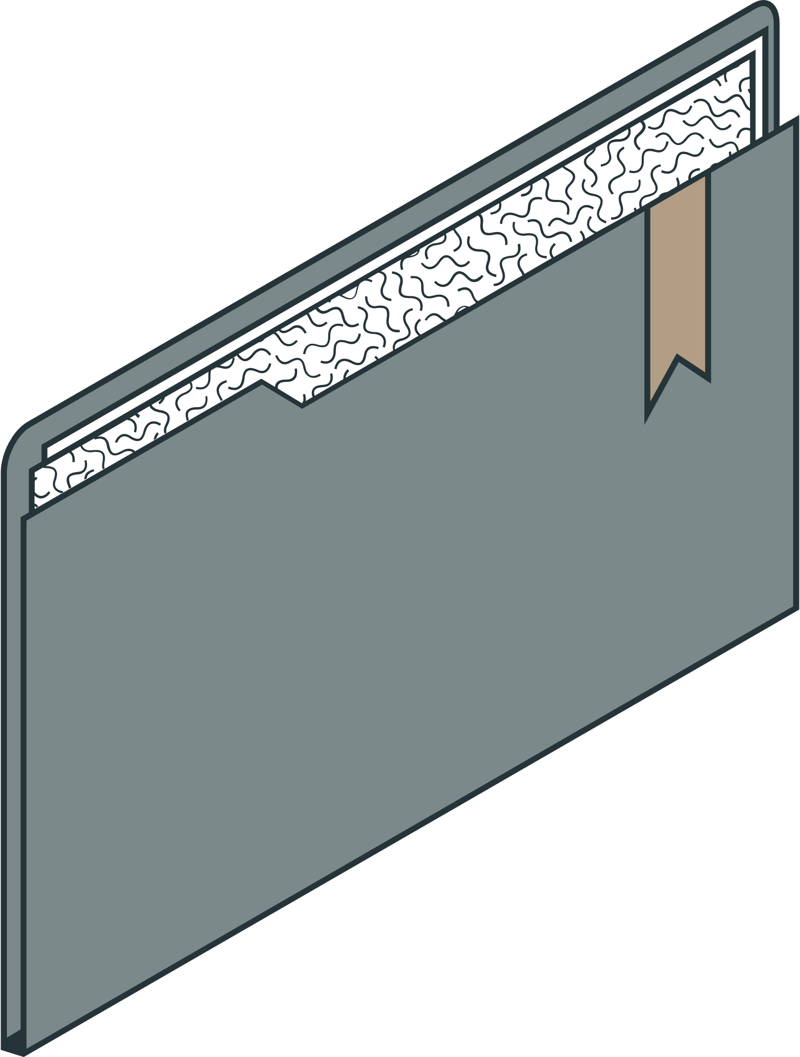
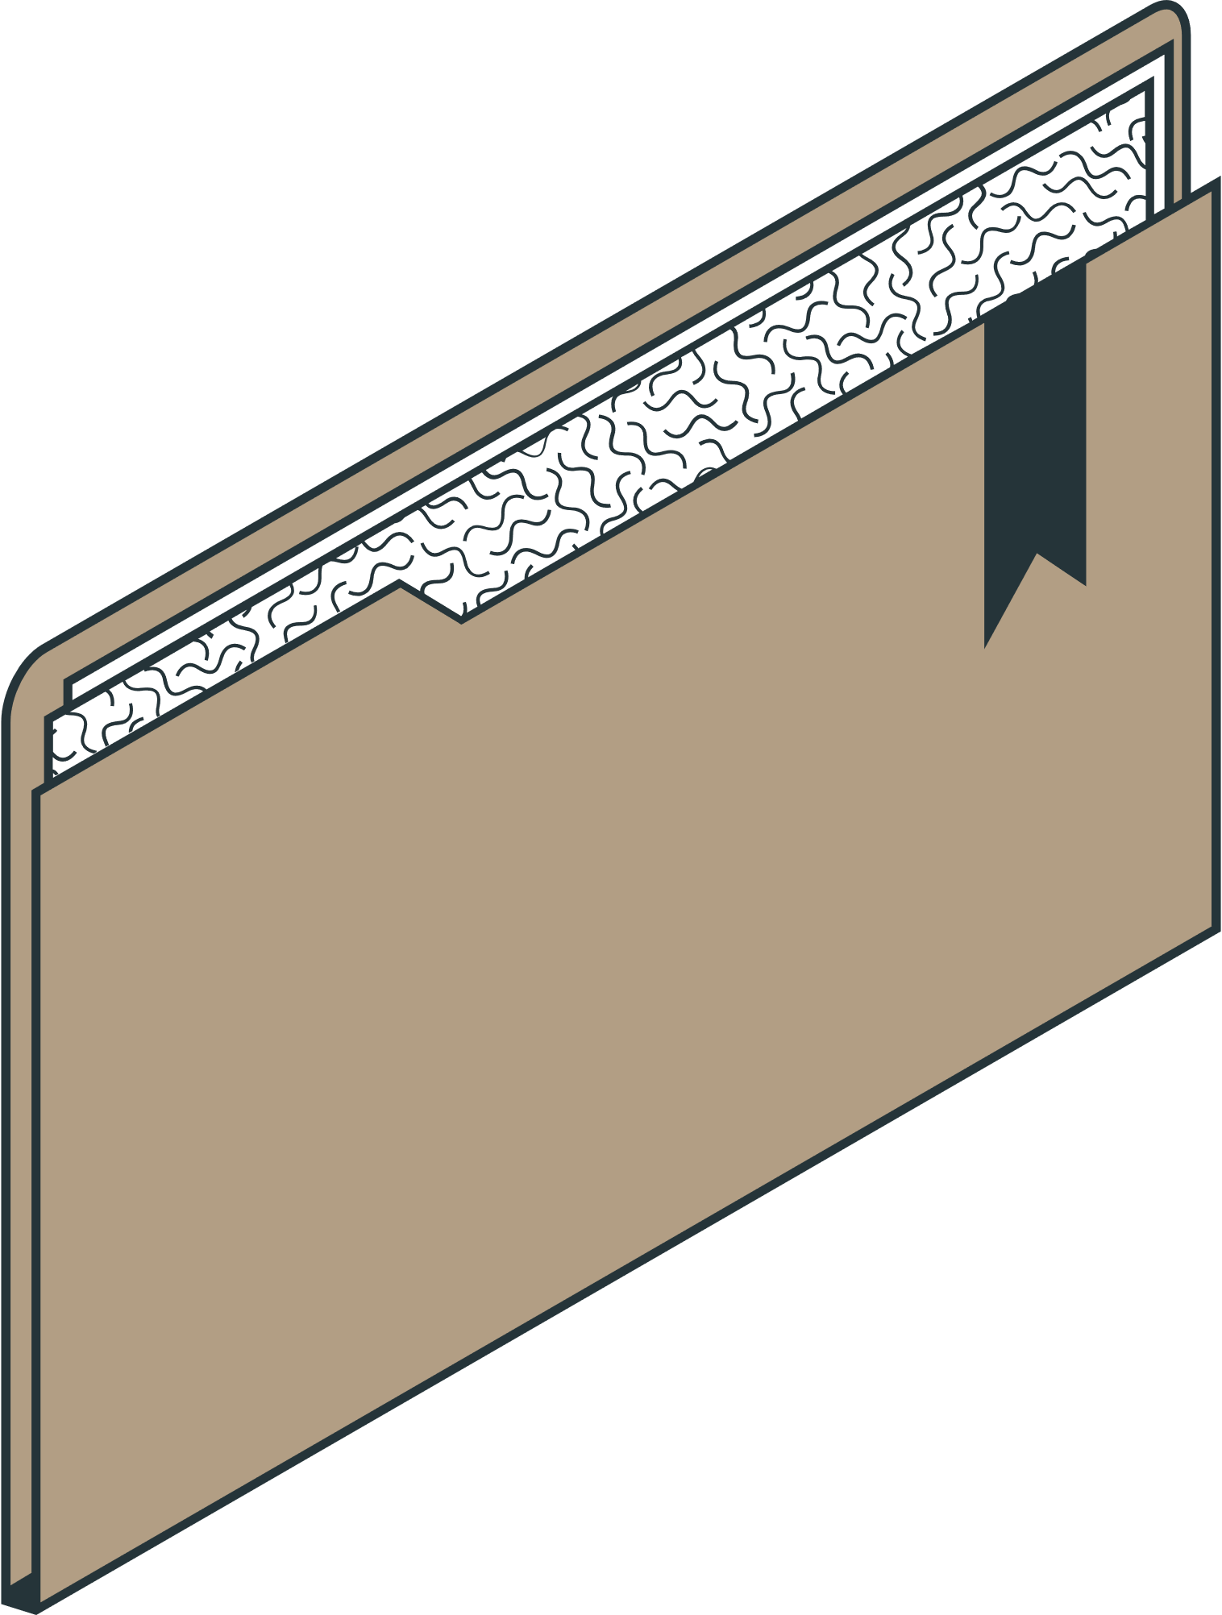
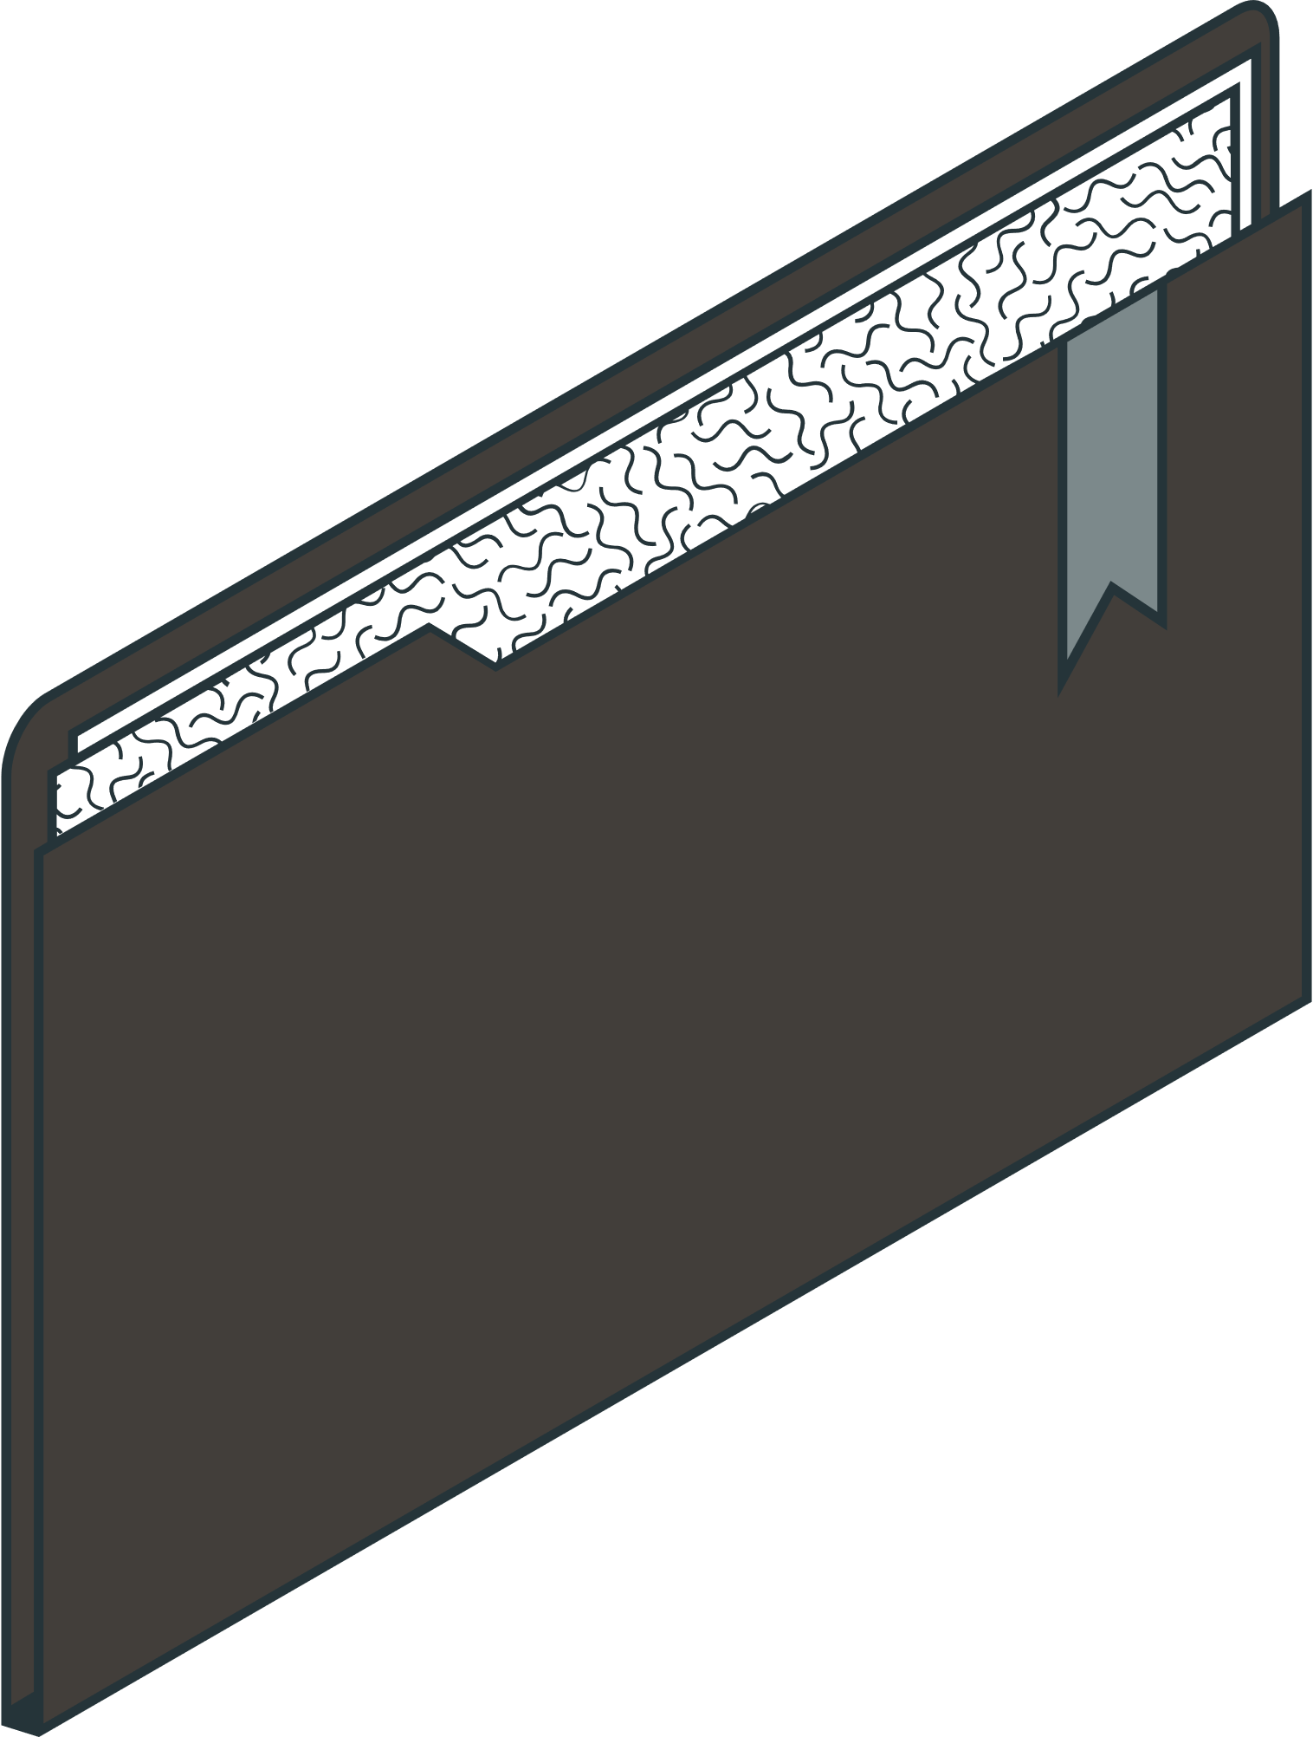
AGENDA
Introduction Software Requirement Specifications Use Case and E-R Diagram Software DEMO

Slide 3

INTRODUCTION

Slide 4

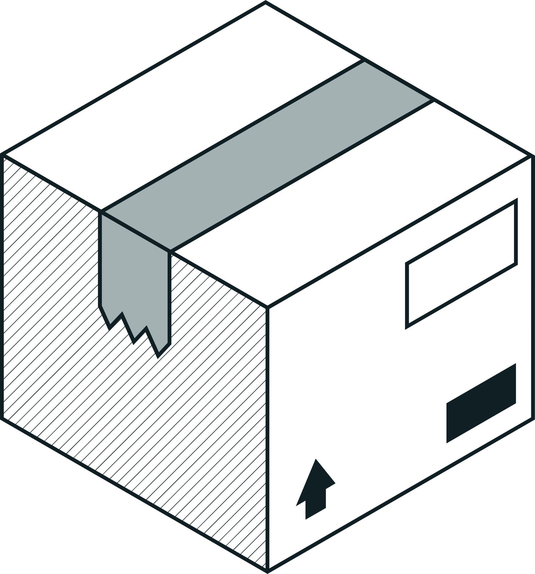

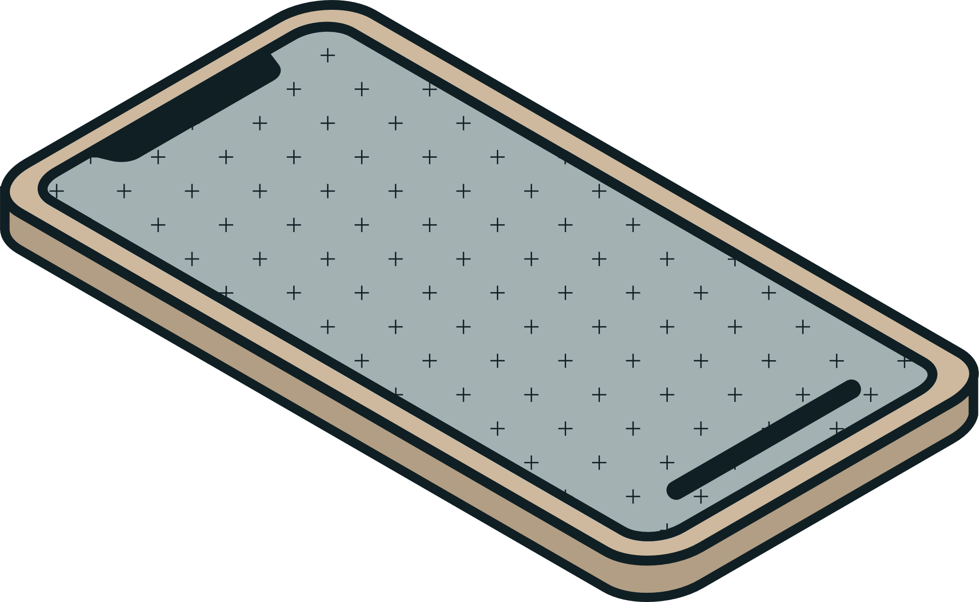
PRODUCT SCOPE AND VALUE | INTENDED AUDIENCE AND USE
The application allows users to locate specific mathematics and statistics theses as a mini-search engine without physically engaging in a library search. The goal is for the app to help students in simplifying the process of searching specific theses quickly. The application enhances user efficiency by swiftly providing a list of specific Mathematics and Statistics theses, accessible anytime and anywhere, saving time and ensuring convenience. | The application is for MSU-IIT users (including different colleges) who seek to search for references or specific Mathematics and Statistics theses works. The application is exclusive only to users within MSU-IIT and shall be accessed locally. The application as a mini-search engine helps the user in search for specific theses works, then provides right after the list of related Mathematics and Statistics theses works.

Slide 5

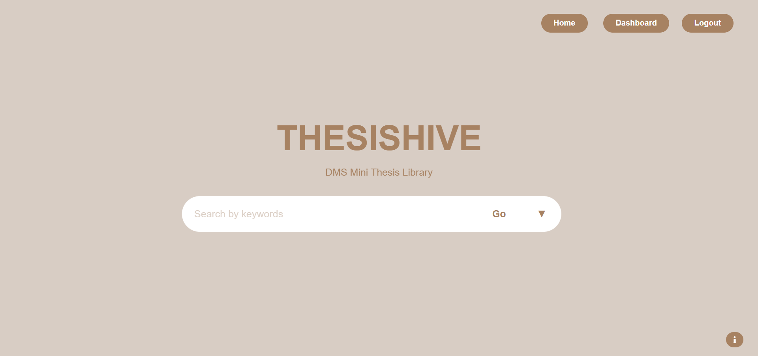
GENERAL DESCRIPTION
The Thesishive: DMS Mini Thesis Library

Slide 6
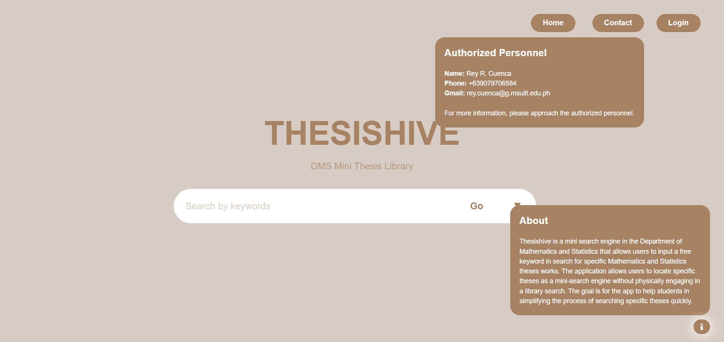
GENERAL DESCRIPTION
The Thesishive: DMS Mini Thesis Library

Slide 7
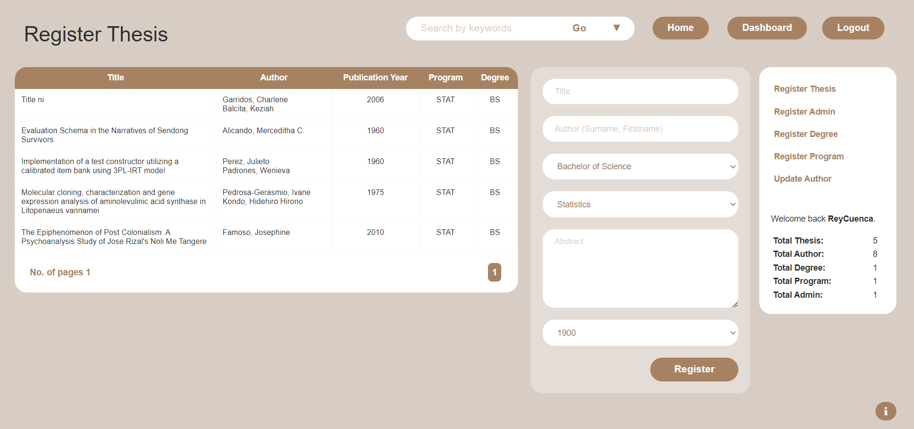
GENERAL DESCRIPTION
The Thesishive: DMS Mini Thesis Library

Slide 8

SOFTWARE REQUIREMENT SPECIFICATION
Functional External Interface Non-Functional

Slide 9
FUNCTIONAL REQUIREMENTS
1
2
3
4
DESIGN
GRAPHICS
OPERATING SYSTEM
CONSTRAINTS
Keywords for search operation
Results in 5 seconds
Rank of search results
View thesis details
Download thesis list
Categorized by degree
Display title and author
Keyword count
Manager’s CRUD
GUI
Search bar
Display for results
Manager interface
Users shall only have access to view the abstract
Minimum operating system requirements are not sufficient.
Windows 10
Offline
No external devices
20 GB drive space
10 GB disk space
i3 with 64-bit operating system, and x64-based processor
4-6 GB RAM

Slide 10
EXTERNAL INTERFACE REQUIREMENTS
1
2
3
USER INTERFACE
HARDWARE INTERFACE
SOFTWARE INTERFACE
Display a list of theses.
Input search information
Choose from the list of results.
The name of the application
Contact information for authorized personnel.
Font size not less than 12 points.
Color scheme: shades of brown.
System Administrator access to CRUD.
Input fields for the System Administrator.
Display error messages for issues.
Meet the operating system requirements
Operates in offline mode
SQL as the database management tool

Slide 11
NON-FUNCTIONAL REQUIREMENTS
1
2
3
4
SECURITY
CAPACITY
COMPATIBILITY
RELIABILITY
Limited access
Clearly define data ownership and establish document retention and deletion policies
Does not allow downloads of the thesis’ abstract
Minimum capacity of 10,000 documents
At least 1 MB of data per document
Efficient indexing of all thesis titles and abstracts
Compatible with common relational database
Compatible on different operating systems
Compatible with standard web browsers
Response time remains within a five-second threshold
Undergo rigorous testing
Working interface button
Regular scheduled system maintenance

Slide 12
NON-FUNCTIONAL REQUIREMENTS
5
6
7
SCALABILITY
MAINTAINABILITY
USABILITY
Adapt its speed for optimal performance
Optimized for tasks such as downloading 20 thesis list within 5 seconds
Leverage Git in conjunction with a Continuous Integration (CI) tool
Git integrated with a CI tool
Git with a CI tool shall function as a safety net
Area or space for specific result information

Slide 13


ADMIN LOG IN
Add Thesis Details
<<include>>
MANAGE DMS THESIS RECORDS
<<include>>
Delete Thesis
<<include>>
ADMIN
Update Thesis
SEARCH THESES - ABSTRACT
BROWSE THESES
USER CASE DIAGRAM
<<extend>>
USER
View Thesis details
<<include>>
READ THESIS DETAILS

Slide 14



Admin
AdminID
Thesis
Program
username
ThesisID
ProgramID
password
ProgramID
Program
DegreeID
Title
PublicationYear
Thesis_Author
Abstract
ThesisID
AuthorID
ENTITY-RELATIONSHIP DIAGRAM
Degree
Author
DegreeID
AuthorID
Degree
Firstname
Surname

Slide 15

THANK YOU FOR LISTENING!
Do you have questions?

